Slide 1
Breweries EDA
Stephanie Duarte
Catherine Ticzon

Slide 2
01
Breweries in each state
Notes:
1. How many breweries are present in each state? (Catherine)

Slide 3
Alabama | 3
Alaska | 7
Arizona | 11
Arkansas | 2
California | 39
Colorado | 47
Connecticut | 8
Delaware | 2
Florida | 15
Georgia | 7
Hawaii | 4
Idaho | 5
Illinois | 18
Indiana | 22
Iowa | 5
Kansas | 3
Kentucky | 4
Louisiana | 5
Maine | 9
Maryland | 7
Massachusetts | 23
Michigan | 32
Minnesota | 12
Mississippi | 2
Missouri | 9
Montana | 9
Nebraska | 5
Nevada | 2
New Hampshire | 3
New Jersey | 3
New Mexico | 4
New York | 16
North Carolina | 19
North Dakota | 1
Ohio | 15
Oklahoma | 6
Oregon | 29
Pennsylvania | 25
Rhode Island | 5
South Carolina | 4
South Dakota | 1
Tennessee | 3
Texas | 28
Utah | 4
Vermont | 10
Virginia | 16
Washington | 23
West Virginia | 1
Wisconsin | 20
Wyoming | 4
Notes:
Dark blue: >30
Light grey: 20-29
1 brewery where State=NA

Slide 4
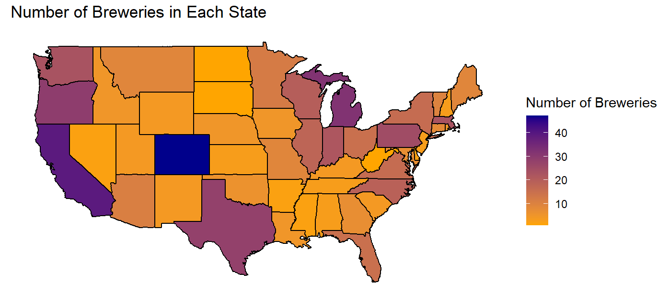
Notes:
Colorado has the most number of breweries, California close second, Michigan about third
Light shades of orange indicate less amount of breweries
**Alaska has 7
3 states - 30 breweries or more
Colorado has the most (47)
7 states - 20-29 breweries:
9 states-10-19 breweries:
31 states- 10 breweries or less:

Slide 5
03
Missing values
Notes:
3. Address the missing values in each column.

Slide 6
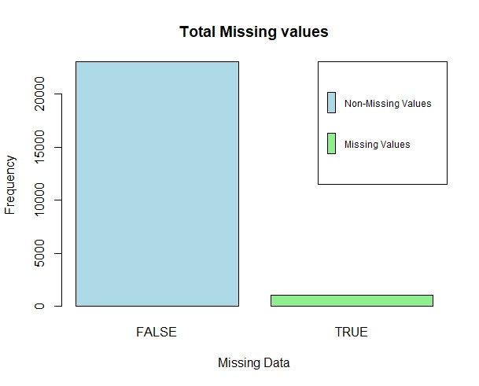
Missing values
44.2% of the data had missi
ng values
ABV column has 2.5% (62) missing values
IBU column has 41.7% (1005) missing values
Some missing values are expected (e.g. IBU for ciders are not rated based of bitterness).
Notes:
Looking at our results, we saw the following 3 columns had missing values. Some nulls in IBU can be explained by the style (e.g. ciders are never rated based off bitterness)This can significantly interfere with our test. Thus, we are going to impute our missing NAs with the average for ABV and IBU.

Slide 7
Handling missing data
Two methods for handling missing data:
Eliminate missing data
Replace missing data with average
Notes:
Looking at our results, we saw the following 3 columns had missing values. Some nulls in IBU can be explained by the style (e.g. ciders are never rated based off bitterness)This can significantly interfere with our test. Thus, we are going to impute our missing NAs with the average for ABV and IBU.

Slide 8
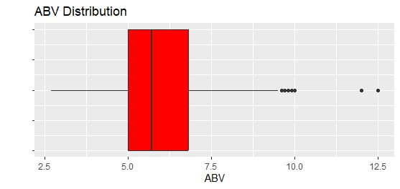
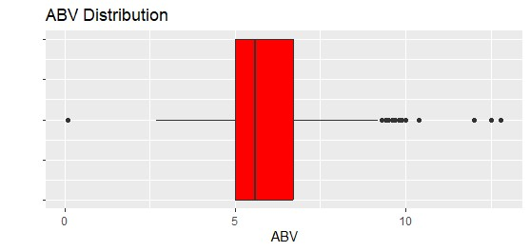
Comparison of methods
Method 1:
Minimum: 2.7%
1st Quartile: 5.0%
Median: 5.7%
3rd Quartile: 6.8%
Mean: 5.992%
Maximum:12.5%
Method 2:
Minimum: 0.1%
1st Quartile: 5.0%
Median: 5.7%
3rd Quartile: 6.7%
Mean: 5.977%
Maximum:12.8%
Notes:
We determined that when removing rows with missing data, the primary difference was with the minimum of ABV, which showed that if we eliminated the missing data we we got a minimum of 2.7% rather than a 0.1% using method 2 ( replacing data with average).

Slide 9
04
Median alcohol content and IBU by state
Notes:
4. Compute the median alcohol content and international bitterness unit for each state. Plot a bar chart to compare. (Catherine)

Slide 10
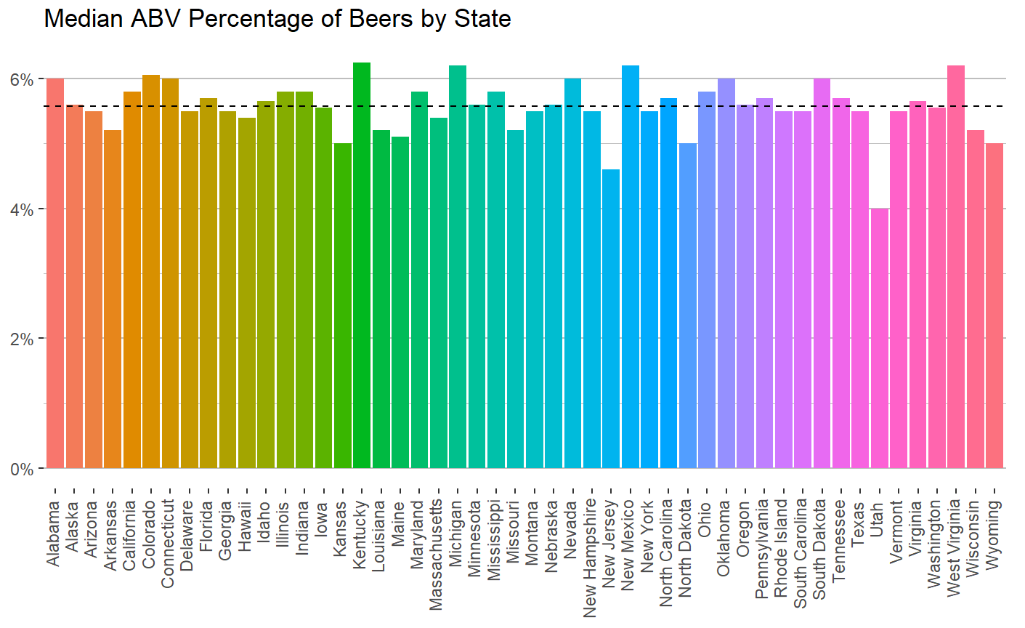
Notes:
Black line is the mean of all state median ABVs = 0.05585294 (~5.6%)
Utah has the lowest median alcohol content (around 4%)
Kentucky, Michigan, NM, and WV are all above 6% - looks like Kentucky has the highest median ABV by a hair

Slide 11
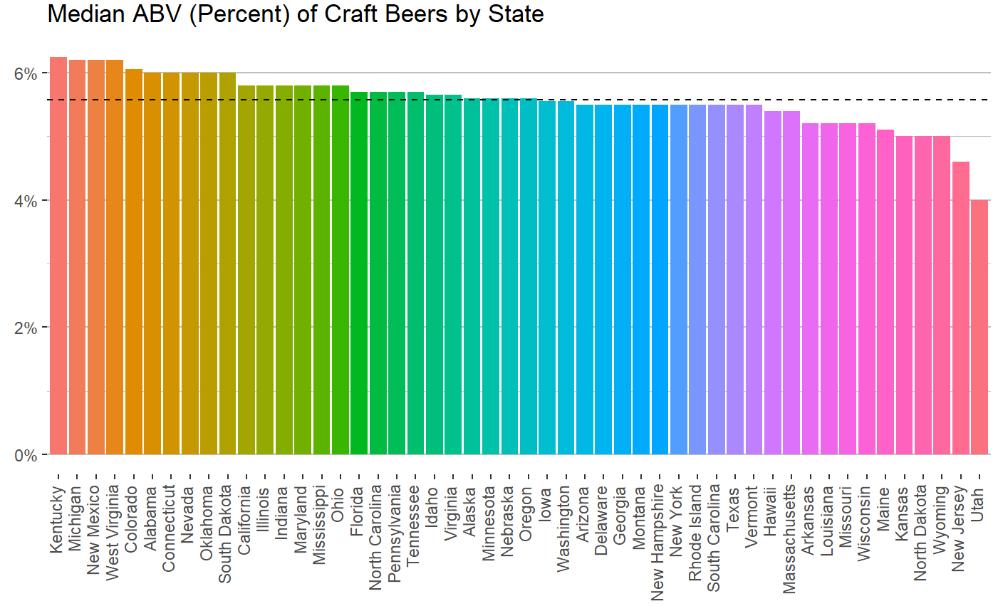
Notes:
Black line is the mean of all state median ABVs = 0.05585294 (~5.6%)
Utah has the lowest median alcohol content (around 4%)
Kentucky, Michigan, NM, and WV are all above 6% - looks like Kentucky has the highest median ABV by a hair

Slide 12
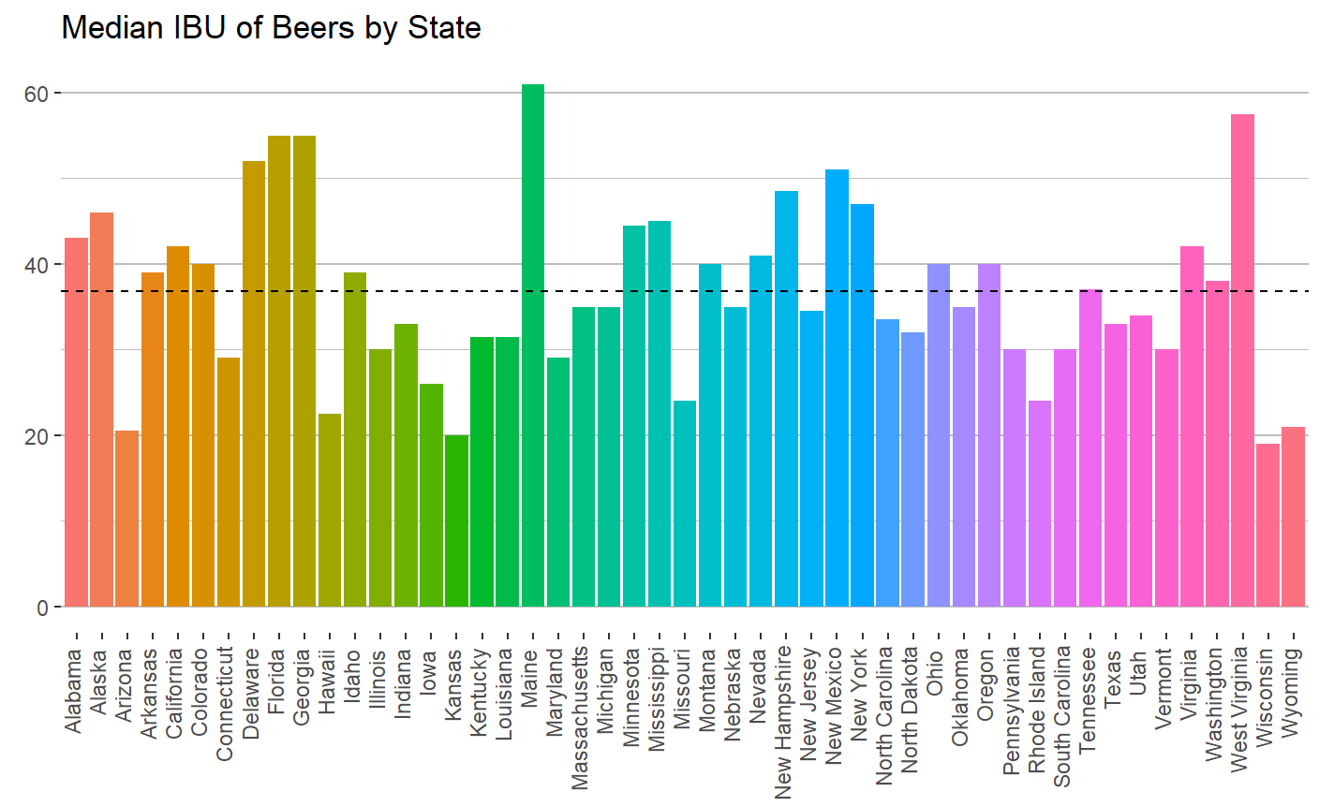
Notes:
Black line is the mean of all state medians of IBU = 36.98
Main has the highest median of IBU, just above 60 IBUs, WV has second highest
Wisconsin has the lowest median IBU at not even 20 IBUs
*Beers in South Dakota did not have corresponding IBU so SD is not on this graph

Slide 13
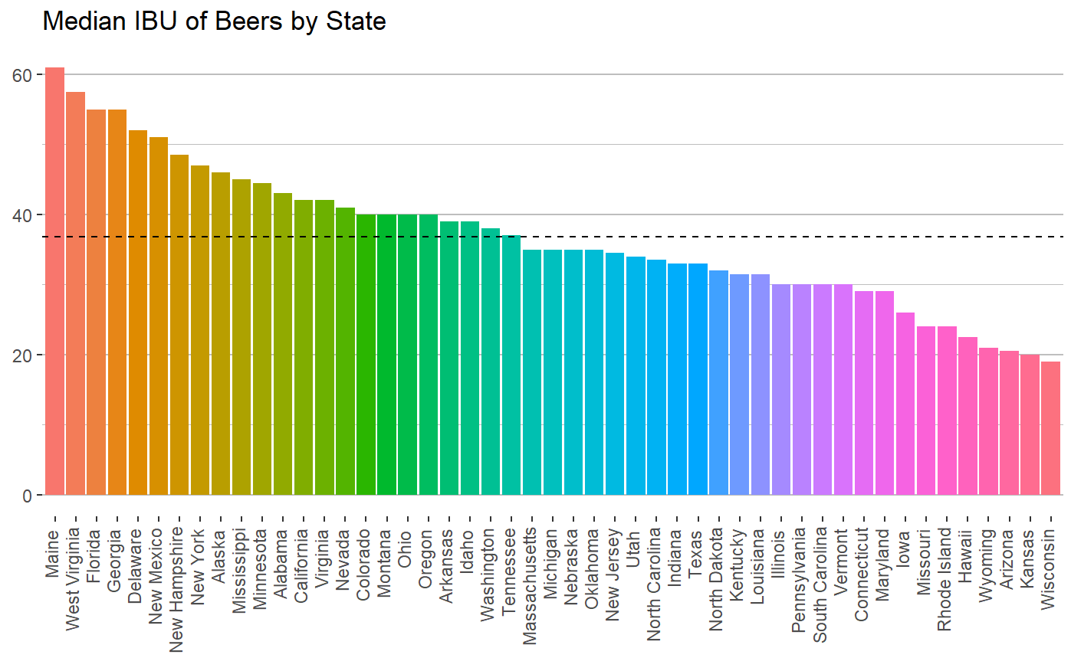
Notes:
Black line is the mean of all state medians of IBU = 36.98
Main has the highest median of IBU, just above 60 IBUs, WV has second highest
Wisconsin has the lowest median IBU at not even 20 IBUs
*Beers in South Dakota did not have corresponding IBU so SD is not on this graph

Slide 14
05
States with maximum ABV and highest IBU
Notes:
5. Which state has the maximum alcoholic (ABV) beer? Which state has the most bitter (IBU) beer?

Slide 15

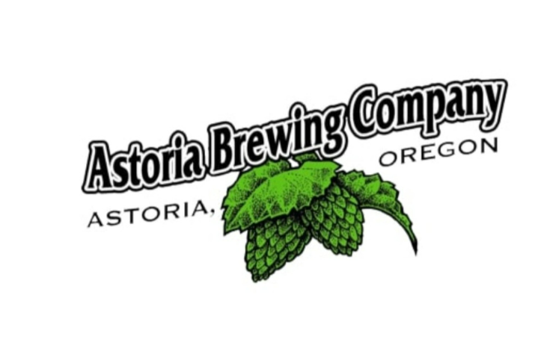
Which state has the Highest ABV and IBU?
Colorado has the most alcoholic (ABV) beer with a value of 0.128
"Lee Hill Series - Belgian Style Quadrupel Ale" made by “Upslope Brewing Company" in Boulder, CO.
Oregon has the most bitter (IBU) beer with a value of 138.
"Bitter Bitch Imperial IPA" made by "Astoria Brewing Company" in Astoria, OR
Notes:
Alcohol by volume of the beer.- Colorado with 12.8%
International Bitterness Units of the beer

Slide 16
06
Statistics and distribution of ABV
Notes:
6. Comment on the summary statistics and distribution of the ABV variable.

Slide 17
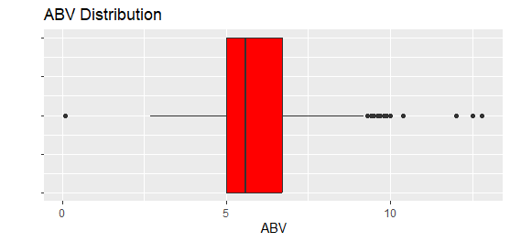
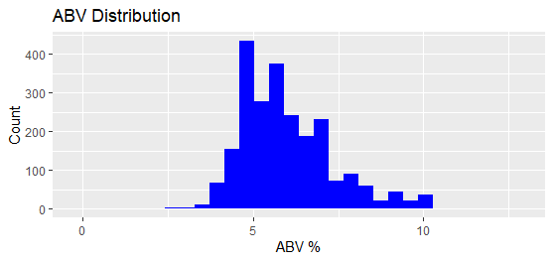
Min | Q1 | Median | Q3 | Max
0.1 | 5.0 | 5.6 | 6.7 | 12.8
Notes:
The average of ABV is 5.977. The distribution of the histogram is right skewed.

Slide 18
07
Bitterness and alcohol content
Notes:
7. Is there an apparent relationship between the bitterness of the beer and its alcoholic content? Draw a scatter plot. Make your best judgment of a relationship and EXPLAIN your answer. (Catherine)

Slide 19
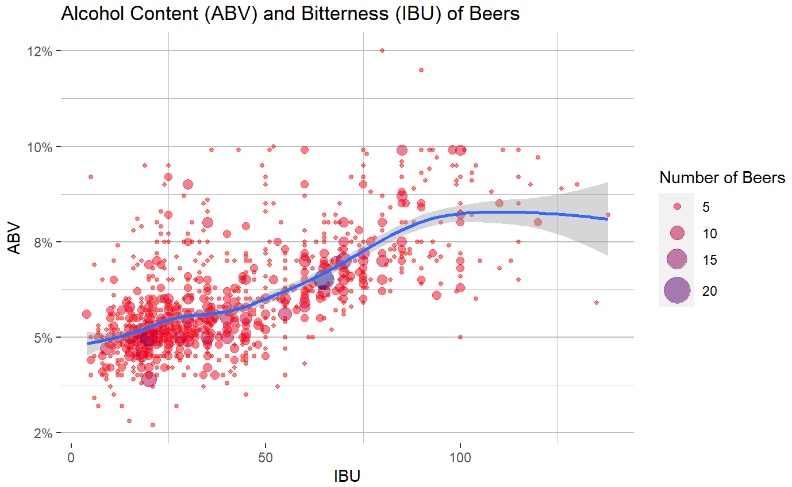
Notes:
Visually, it looks like there is some evidence of a positive relationship between alcohol content and bitterness.
We see a large cluster of beers around the 5% ABV and 25 IBUs area, though as we see IBU increase, ABV also generally increases

Slide 20
08
IPAs and other ales
Notes:
8. Budweiser would also like to investigate the difference with respect to IBU and ABV between IPAs (India Pale Ales) and other types of Ale (any beer with “Ale” in its name other than IPA). You decide to use KNN classification to investigate this relationship. Provide statistical evidence one way or the other. You can of course assume your audience is comfortable with percentages … KNN is very easy to understand conceptually. In addition, while you have decided to use KNN to investigate this relationship (KNN is required) you may also feel free to supplement your response to this question with any other methods or techniques you have learned. Creativity and alternative solutions are always encouraged.

Slide 21
What is the probability that any type of ale with 5.6% ABV is an IPA?
Knn classifier where k=5
6% chance that the beer is an IPA (94.11% probability that it is another ale)
Notes:
5.6% is the mean of the medians of ABV across all states.
We will see in the next couple slides how IPAs generally have higher ABV than other types of beers.

Slide 22
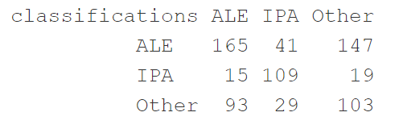
Knn classifications
Knn model to iterate from k=1 to k=100
Across all styles of beer (IPA, other ales and other beers)
k=5 has the most accuracy in classification (52.59%)
Of the other ales, 39.56% were incorrectly classified
Of the IPAS, 39.1% were incorrectly classified
Of the other types of beers (neither ale nor IPA), 61.71% were incorrectly classified
Notes:
+ Accuracy is 52.29%
+ Of the other ales, 39.56% were incorrectly classified
+ Of the IPAS, 39.1% were incorrectly classified
+ Of the other types of beers (neither ale nor IPA), 61.71% were incorrectly classified

Slide 23
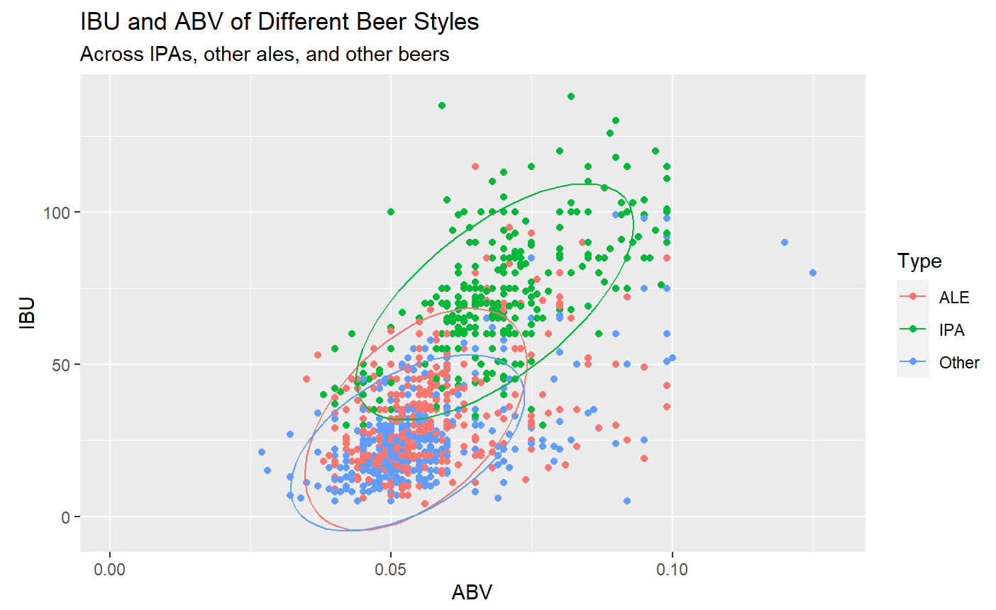

Slide 24
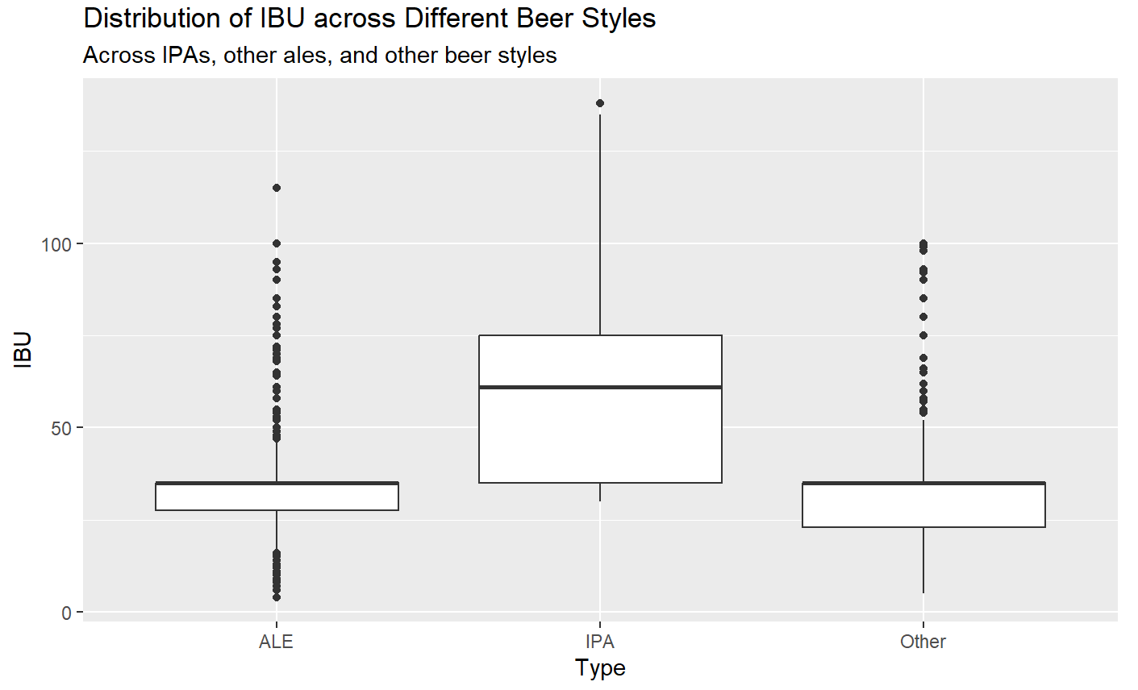

Slide 25
Thank you!
Reach out with any questions or comments
Stephanie Duarte - duartes@smu.edu
Catherine Ticzon - cticzon@smu.edu

Slide 26
Presentation Link
https://drive.google.com/file/d/1_z_hYbqwNg1nXkuXl8Rv49pB-FTsnt0g/view?usp=sharing

